Slide 1
GENESIS 3:15

Slide 2
Genesis 3:15
[The Lord God said to the serpent,]
“I will put enmity
between you and the woman,
and between your seed and hers;
he will crush your head,
and you will strike his heel.”
Jesus Christ
Satan
Jesus's ultimate victory over Satan
Jesus's death on the cross

Slide 3
The Missionaries’ Interpretation
“her [seed]” (Eve’s descendant) refers to Jesus Christ.
“your seed” (the serpent’s successor) is Satan.
“you will strike his heel” refers to Jesus' death on the cross.
A wounded heel can heal — Jesus was resurrected.
“he will crush your head” refers to Jesus’ ultimate victory over Satan in the future.
A crushed head is fatal; you cannot recover.
The verse hints at the virgin birth of Jesus.
Genealogies (seed) are normally through men, not women.
Jesus’ human seed came from his mother, not his father`

Slide 4
Genesis 3:15 Revisited
[The Lord God said to the serpent,]
“I will put enmity
between you and the woman,
and between your seed and hers;
he will crush your head,
and you will strike his heel.”
humans
snakes
stepping on snakes
snake bites

Slide 5
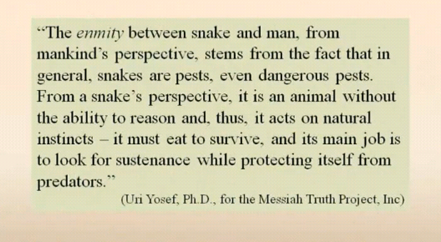
The Anti-missionaries’ Interpretation
The verse simply speaks of the enmity that exists between mankind and snakes
there is enmity because snakes are pests to humans

Slide 6
The Anti-missionaries’ Counter Arguments
In this verse, “זַרְעָהּ” (her seed) is plural, not singular
It refers to mankind in general, not to one man.
“seed” is always physical and never spiritual.
The verse is talking about literal snakes, not Satan.

Slide 7
The Missionaries’ “Counter-Counter” Argument
“Seed” is not always simply physical.
Oh, sinful nation [Israel],
People weighed down with guilt,
Seed of evildoers,
Sons who act corruptly!
[Isaiah 1:4a, NIV]
Jesus said to the Jews, “You are of your father the devil…” [John 8:44a, NIV]
The context of Genesis 3 speaks in favor of a spiritual, not simply physical, interpretation.
temptation, disobedience, sin, etc.

Slide 8
The Missionaries’ “Counter-Counter” Argument
“זֶַרַע” can be singular.
Adam had relations with his wife again; and she gave birth to a son, and named him Seth, for, she said, “God has appointed me another child (זֶַרַע) in place of Abel, because Cain killed him.”
[Genesis 4:25, NIV]
Is it singular or plural in Genesis 3:15?
…he will crush your head, and you will strike his heel. [Genesis 3:15b, NIV]

Slide 9
Earlier Jewish Sources
“And I will put enmity between thee and the woman, and between the seed of thy son, and the seed of her sons; and it shall be when the sons of the woman keep the commandments of the law, they will be prepared to smite thee upon thy head; but when they forsake the commandments of the law, thou wilt be ready to wound them in their heel. Nevertheless for them there shall be a medicine, but for thee there will be no medicine; and they shall make a remedy for the heel in the days of the King Meshiha.” [Targum Jonathan on Genesis 3]
In the Septuagint, the Jewish translators translated “זַרְעֲךָ” into “σπέρματος,” which is singular.

Slide 10
In Conclusion
You may decide who to believe.

