Slide 1
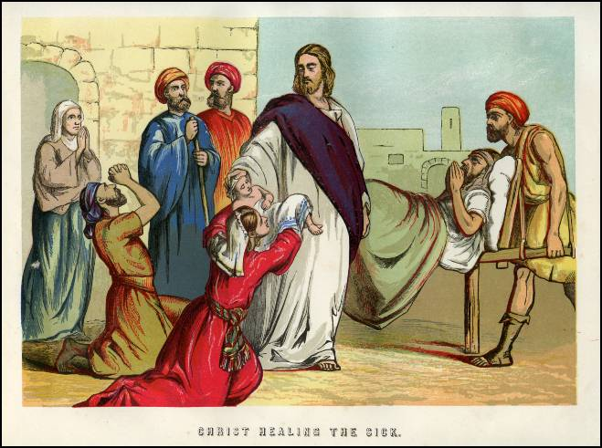
ISAIAH 35:5-6a

Slide 2
Isaiah 35:5-6a
“Then will the eyes of the blind be opened and the ears of the deaf unstopped. Then will the lame leap like a deer, and the mute tongue shout for joy.”

Slide 3
The Missionaries’ Claim
Jesus performed these miracles.
Great crowds came to [Jesus], bringing the lame, the blind, the crippled, the mute and many others, and laid them at his feet; and he healed them. [Matthew 15:30, NIV]
“The blind receive sight, the lame walk, those who have leprosy are cleansed, the deaf hear, the dead are raised, and the good news is proclaimed to the poor.” [Luke 7:22b, NIV]
Jesus’ miracles show us that he was the Messiah.
Jesus performed many other signs in the presence of his disciples, which are not recorded in this book. But these are written that you may believe that Jesus is the Messiah, the Son of God, and that by believing you may have life in his name. [John 20:30-31, NIV]

Slide 4
The Anti-Missionaries’ Arguments
Many people performed miracles.
Aaron threw his staff down in front of Pharaoh and his officials, and it became a snake. Pharaoh then summoned wise men and sorcerers, and the Egyptian magicians also did the same things by their secret arts: Each one threw down his staff and it became a snake. [Exodus 7:10b-12a, NIV]
[Samson] got up and took hold of the doors of the city gate, together with the two posts, and tore them loose, bar and all. He lifted them to his shoulders and carried them to the top of the hill that faces Hebron. [Judges 16:3b, NIV]
Once while some Israelites were burying a man, suddenly they saw a band of raiders; so they threw the man’s body into Elisha’s tomb. When the body touched Elisha’s bones, the man came to life and stood up on his feet. [II Kings 13:21, NIV]

Slide 5
The Anti-Missionaries’ Arguments
God uses miracles to test our faith.
If a prophet, or one who foretells by dreams, appears among you and announces to you a sign or wonder, and if the sign or wonder spoken of takes place, and the prophet says, “Let us follow other gods” (gods you have not known) “and let us worship them,” you must not listen to the words of that prophet or dreamer. The Lord your God is testing you to find out whether you love him with all your heart and with all your soul. [Deuteronomy 13:1-3, NIV]
“But a prophet who presumes to speak in my name anything I have not commanded, or a prophet who speaks in the name of other gods, is to be put to death.” You may say to yourselves, “How can we know when a message has not been spoken by the Lord?” If what a prophet proclaims in the name of the Lord does not take place or come true, that is a message the Lord has not spoken. That prophet has spoken presumptuously, so do not be alarmed. [Deuteronomy 18:20-22, NIV]

Slide 6
The Anti-Missionaries’ Arguments
Miracles are not proof of even being God’s servant.
The Jews did not believe in Moses, our teacher, because of the miracles he performed. Whenever anyone’s belief is based on seeing miracles, he has lingering doubts, because it is possible the miracles were performed through magic or sorcery. All of the miracles performed by Moses in the desert were because they were necessary, and not as proof of his prophecy. [Maimonides, Foundations of Torah, ch. 8]

Slide 7
The Anti-Missionaries’ Arguments
Even Jesus said that false Messiahs can perform miracles.
“For false messiahs and false prophets will appear and perform great signs and wonders to deceive, if possible, even the elect.” [Matthew 24:24, NIV]
It may also be interesting to note that while most missionaries will cite Jesus’ performance of miracles as proof that he is the messiah, the New Testament itself... indicates that there could be false messiahs who present miracles in order to trick God’s people, but they are false. This being the case, miracles prove nothing, and the fact that the New Testament claims that Jesus did miracles prove nothing concerning Jesus’ role as messiah or his alleged divinity. [Penina Taylor, anti-missionary]

Slide 8
The Anti-Missionaries’ Arguments
The Bible never said that the Messiah will perform miracles.
Isaiah 35 says that God will perform the miracles.
“Be strong, do not fear; your God will come, he will come with vengeance; with divine retribution he will come to save you.” Then will the eyes of the blind be opened and the ears of the deaf unstopped. Then will the lame leap like a deer, and the mute tongue shout for joy. [Isaiah 35:4b-6a, NIV]
One should not presume that the Messianic King must work miracles and wonders, bring about new creations within the world, resurrect the dead, or perform other similar deeds. This is definitely not true. [Maimonides, Laws of Kings]
The identity of the Messiah will not be determined by miracles and wonders, but by his ability to lead the Jewish People to a more complete observance of the [law] and [good works]. He will then improve the entire world, motivating the people of every nation to serve God together. [Maimonides, Laws of Kings]
The question which must be asked is, “Does the Jewish Bible tell us that we be able to recognize the messiah because he will perform miracles?” Not only is there no evidence anywhere in the Jewish bible to support the claim that the messiah will perform miracles, we have very concrete examples in the [Old Testament] of people performing miracles who were considered wicked. [Penina Taylor, anti-missionary]

Slide 9
The Missionaries’ Rebuttal
God uses miracles to test our faith.
If a prophet, or one who foretells by dreams, appears among you and announces to you a sign or wonder, and if the sign or wonder spoken of takes place, and the prophet says, “Let us follow other gods” (gods you have not known) “and let us worship them,” you must not listen to the words of that prophet or dreamer. The Lord your God is testing you to find out whether you love him with all your heart and with all your soul. [Deuteronomy 13:1-3, NIV]
Jesus did not teach people to follow other gods.
“But a prophet who presumes to speak in my name anything I have not commanded, or a prophet who speaks in the name of other gods, is to be put to death.” You may say to yourselves, “How can we know when a message has not been spoken by the Lord?” If what a prophet proclaims in the name of the Lord does not take place or come true, that is a message the Lord has not spoken. That prophet has spoken presumptuously, so do not be alarmed. [Deuteronomy 18:20-22, NIV]
Jesus’ prophesies came true.

Slide 10
The Missionaries’ Rebuttal
Miracles are not even proof of being God’s servant.
The miracles don’t prove Jesus was the Messiah, but they provide evidence that he was.
Jesus performed many other signs in the presence of his disciples, which are not recorded in this book. But these are written that you may believe that Jesus is the Messiah, the Son of God, and that by believing you may have life in his name. (John 20:30-31)

Slide 11
The Missionaries’ Rebuttal
The Bible never said that the Messiah will perform miracles.
True, but the Dead Sea scrolls did.
[The hea]vens and the earth will listen to His Messiah,… He who… restores sight to the blind, straightens the b[ent]… And the Lord... will heal the wounded, and revive the dead. [Dead Sea Scroll 4Q521 — “Messianic Apocalypse”]

Slide 12
In Conclusion
You may decide who to believe.

