Slide 1
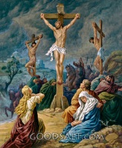
ISAIAH 53

Slide 2
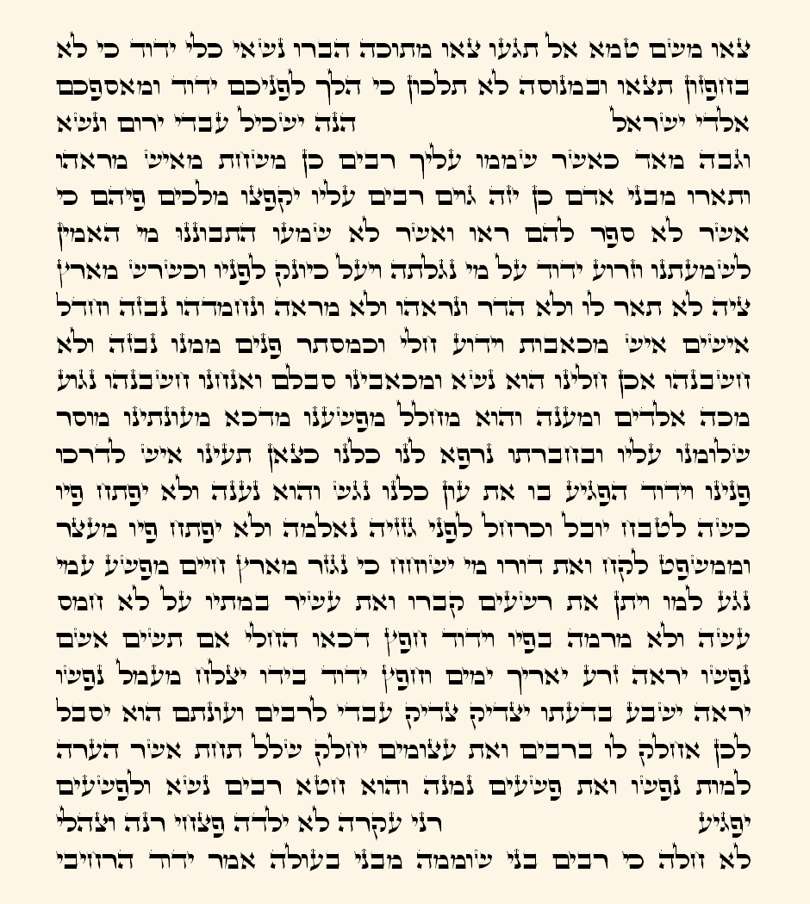
Isaiah 52:13 - 53:12
Isaiah 52:13
Isaiah 54:1

Slide 3
Isaiah 53 [NIV]
God’s
Jesus
his ascension to Heaven
See, my servant will act wisely; he will be raised and lifted up and highly exalted. Just as there were many who were appalled at him — his appearance was so disfigured beyond that of any human being and his form marred beyond human likeness — so he will sprinkle many nations, and kings will shut their mouths because of him. For what they were not told, they will see, and what they have not heard, they will understand.
Who has believed our message and to whom has the arm of the Lord been revealed? He grew up before him like a tender shoot, and like a root out of dry ground. He had no beauty or majesty to attract us to him, nothing in his appearance that we should desire him. He was despised and rejected by mankind, a man of suffering, and familiar with pain. Like one from whom people hide their faces he was despised, and we held him in low esteem.
be
surprised
unbelievers
by the Jewish leaders

Slide 4
Isaiah 53:4-9 [NIV]
All humans’
Surely he took up our pain and bore our suffering, yet we considered him punished by God, stricken by him, and afflicted. But he was pierced for our transgressions, he was crushed for our iniquities; the punishment that brought us peace was on him, and by his wounds we are healed. We all, like sheep, have gone astray, each of us has turned to our own way; and the Lord has laid on him the iniquity of us all.
He was oppressed and afflicted, yet he did not open his mouth; he was led like a lamb to the slaughter, and as a sheep before its shearers is silent, so he did not open his mouth. By oppression and judgment he was taken away. Yet who of his generation protested? For he was cut off from the land of the living; for the transgression of my people he was punished. He was assigned a grave with the wicked, and with the rich in his death, though he had done no violence, nor was any deceit in his mouth.
sins
crucified
salvation
killed
two thieves
Joseph of Arimathea

Slide 5
Isaiah 53:10-12 [NIV]
beaten, flogged, mocked, and crucified
Yet it was the Lord’s will to crush him and cause him to suffer, and though the Lord makes his life an offering for sin, he will see his offspring and prolong his days, and the will of the Lord will prosper in his hand. After he has suffered, he will see the light of life and be satisfied; by his knowledge my righteous servant will justify many, and he will bear their iniquities. Therefore I will give him a portion among the great, and he will divide the spoils with the strong, because he poured out his life unto death, and was numbered with the transgressors. For he bore the sin of many, and made intercession for the transgressors.
be resurrected

Slide 6
The Missionaries’ Interpretation
The suffering servant is Jesus Christ.
The prophecy describes his crucifixion, his death, his resurrection, and his future exaltation.
It states Jesus died to atone for our sins clearly, concisely, and repeatedly:
But he was pierced for our transgressions,
he was crushed for our iniquities;
the punishment that brought us peace was on him,
and by his wounds we are healed. [Isaiah 53:4, NIV]
The Lord has laid on him the iniquity of us all. [Isaiah 53:6b, NIV]
For the transgression of my people he was punished. [Isaiah 53:8b, NIV]
The Lord makes his life an offering for sin, [Isaiah 53:10c, NIV]
My righteous servant will justify many,
and he will bear their iniquities. [Isaiah 53:11b, NIV]
he bore the sin of many,
and made intercession for the transgressors. [Isaiah 53:12b, NIV]

Slide 7
Isaiah 53 [NIV]
God’s
Jews
in the Messianic age
See, my servant will act wisely; he will be raised and lifted up and highly exalted. Just as there were many who were appalled at him — his appearance was so disfigured beyond that of any human being and his form marred beyond human likeness — so he will sprinkle many nations, and kings will shut their mouths because of him. For what they were not told, they will see, and what they have not heard, they will understand.
Who has believed our message and to whom has the arm of the Lord been revealed? He grew up before him like a tender shoot, and like a root out of dry ground. He had no beauty or majesty to attract us to him, nothing in his appearance that we should desire him. He was despised and rejected by mankind, a man of suffering, and familiar with pain. Like one from whom people hide their faces he was despised, and we held him in low esteem.
Gentile leaders
when they learn that the Messiah is not Jesus
by the Gentiles

Slide 8
Isaiah 53:4-9 [NIV]
for rejecting Jesus
Surely he took up our pain and bore our suffering, yet we considered him punished by God, stricken by him, and afflicted. But he was pierced for our transgressions, he was crushed for our iniquities; the punishment that brought us peace was on him, and by his wounds we are healed. We all, like sheep, have gone astray, each of us has turned to our own way; and the Lord has laid on him the iniquity of us all.
He was oppressed and afflicted, yet he did not open his mouth; he was led like a lamb to the slaughter, and as a sheep before its shearers is silent, so he did not open his mouth. By oppression and judgment he was taken away. Yet who of his generation protested? For he was cut off from the land of the living; for the transgression of my people he was punished. He was assigned a grave with the wicked, and with the rich in his death, though he had done no violence, nor was any deceit in his mouth.
Gentiles’
sins
persecuted
exiled
Israel

Slide 9
Isaiah 53:10-12 [NIV]
persecution
Yet it was the Lord’s will to crush him and cause him to suffer, and though the Lord makes his life an offering for sin, he will see his offspring and prolong his days, and the will of the Lord will prosper in his hand. After he has suffered, he will see the light of life and be satisfied; by his knowledge my righteous servant will justify many, and he will bear their iniquities. Therefore I will give him a portion among the great, and he will divide the spoils with the strong, because he poured out his life unto death, and was numbered with the transgressors. For he bore the sin of many, and made intercession for the transgressors.
the resurrection of the state of Israel

Slide 10
The Anti-Missionaries’ Interpretation
The suffering servant is the nation of Israel (the Jews).
The Gentiles caused the Jews to suffer.
The Assyrian, Babylonian, and Roman exiles
The crusades
The inquisition
Pogroms
The holocaust
The Jewish people died to the promised land when they were exiled and then rose back to life in the creation of the state of Israel.
The Jews will be exalted when the real Messiah comes, and the Gentiles will be astonished.
The Gentiles thought the Jews were suffering for their (the Jews’) sins (rejecting Jesus), but it was really the Gentiles who were committing sins against the Jews.
… the prevailing rabbinic interpretation of Isaiah 53 ascribes the ‘servant’ to the nation of Israel [the Jews] who silently endured unimaginable suffering at the hands of its gentile oppressors. The speakers, in this most-debated chapter, are the stunned kings of nations who will bear witness to the messianic age and the final vindication of the Jewish people following their long and bitter exile. [Rabbi Tovia Singer]

Slide 11
The Anti-Missionaries’ Arguments
The nation of Israel is God’s servant.
Throughout the book of Isaiah, God often refers to Jacob/Israel (the Jews) as “my servant”.
“But you, Israel, my servant, Jacob, whom I have chosen, you descendants of Abraham my friend, I took you from the ends of the earth, from its farthest corners I called you. I said, ‘You are my servant’; I have chosen you and have not rejected you.” [Isaiah 41:8-9, NIV]
“But now listen, Jacob, my servant, Israel, whom I have chosen...” [Isaiah 44:1, NIV]
“Do not be afraid, Jacob, my servant, Jeshurun [upright one] whom I have chosen.” [Isaiah 44:2b, NIV]
“Remember these things, Jacob, for you, Israel, are my servant. I have made you, you are my servant...” [Isaiah 44:21, NIV]
“For the sake of Jacob my servant, of Israel my chosen...” [Isaiah 45:4a, NIV]
“The Lord has redeemed his servant Jacob.” [Isaiah 48:20b, NIV]
See also Isaiah 49:3-6, and 65:8-16.
This context makes it clear that the suffering servant of Isaiah 53 is the Jews.
The nation of Israel is God’s servant.
Throughout the book of Isaiah, God often refers to Jacob/Israel (the Jews) as “my servant”.
“But you, Israel, my servant, Jacob, whom I have chosen, you descendants of Abraham my friend, I took you from the ends of the earth, from its farthest corners I called you. I said, ‘You are my servant’; I have chosen you and have not rejected you.” [Isaiah 41:8-9, NIV]
The nation of Israel is God’s servant.
Throughout the book of Isaiah, God often refers to Jacob/Israel (the Jews) as “my servant”.
“But you, Israel, my servant, Jacob, whom I have chosen, you descendants of Abraham my friend, I took you from the ends of the earth, from its farthest corners I called you. I said, ‘You are my servant’; I have chosen you and have not rejected you.” [Isaiah 41:8-9, NIV]
“But now listen, Jacob, my servant, Israel, whom I have chosen...” [Isaiah 44:1, NIV]
“Do not be afraid, Jacob, my servant, Jeshurun [upright one] whom I have chosen.” [Isaiah 44:2b, NIV]
“Remember these things, Jacob, for you, Israel, are my servant. I have made you, you are my servant...” [Isaiah 44:21, NIV]
The nation of Israel is God’s servant.
Throughout the book of Isaiah, God often refers to Jacob/Israel (the Jews) as “my servant”.
“But you, Israel, my servant, Jacob, whom I have chosen, you descendants of Abraham my friend, I took you from the ends of the earth, from its farthest corners I called you. I said, ‘You are my servant’; I have chosen you and have not rejected you.” [Isaiah 41:8-9, NIV]
“But now listen, Jacob, my servant, Israel, whom I have chosen...” [Isaiah 44:1, NIV]
“Do not be afraid, Jacob, my servant, Jeshurun [upright one] whom I have chosen.” [Isaiah 44:2b, NIV]
The nation of Israel is God’s servant.
Throughout the book of Isaiah, God often refers to Jacob/Israel (the Jews) as “my servant”.
“But you, Israel, my servant, Jacob, whom I have chosen, you descendants of Abraham my friend, I took you from the ends of the earth, from its farthest corners I called you. I said, ‘You are my servant’; I have chosen you and have not rejected you.” [Isaiah 41:8-9, NIV]
“But now listen, Jacob, my servant, Israel, whom I have chosen...” [Isaiah 44:1, NIV]
The nation of Israel is God’s servant.
Throughout the book of Isaiah, God often refers to Jacob/Israel (the Jews) as “my servant”.
“But you, Israel, my servant, Jacob, whom I have chosen, you descendants of Abraham my friend, I took you from the ends of the earth, from its farthest corners I called you. I said, ‘You are my servant’; I have chosen you and have not rejected you.” [Isaiah 41:8-9, NIV]
“But now listen, Jacob, my servant, Israel, whom I have chosen...” [Isaiah 44:1, NIV]
“Do not be afraid, Jacob, my servant, Jeshurun [upright one] whom I have chosen.” [Isaiah 44:2b, NIV]
“Remember these things, Jacob, for you, Israel, are my servant. I have made you, you are my servant...” [Isaiah 44:21, NIV]
“For the sake of Jacob my servant, of Israel my chosen...” [Isaiah 45:4a, NIV]
The nation of Israel is God’s servant.
Throughout the book of Isaiah, God often refers to Jacob/Israel (the Jews) as “my servant”.
“But you, Israel, my servant, Jacob, whom I have chosen, you descendants of Abraham my friend, I took you from the ends of the earth, from its farthest corners I called you. I said, ‘You are my servant’; I have chosen you and have not rejected you.” [Isaiah 41:8-9, NIV]
“But now listen, Jacob, my servant, Israel, whom I have chosen...” [Isaiah 44:1, NIV]
“Do not be afraid, Jacob, my servant, Jeshurun [upright one] whom I have chosen.” [Isaiah 44:2b, NIV]
“Remember these things, Jacob, for you, Israel, are my servant. I have made you, you are my servant...” [Isaiah 44:21, NIV]
“For the sake of Jacob my servant, of Israel my chosen...” [Isaiah 45:4a, NIV]
“The Lord has redeemed his servant Jacob.” [Isaiah 48:20b, NIV]

Slide 12
The Anti-Missionaries’ Arguments
Jesus didn’t fulfill all of the prophesy in Isaiah 53
He was oppressed and afflicted, yet he did not open his mouth; he was led like a lamb to the slaughter, and as a sheep before its shearers is silent, so he did not open his mouth. [Isaiah 53:7]
Jesus was not silent on the cross.
He was assigned a grave with the wicked, and with the rich in his death... [Isaiah 53:9a]
Jesus was assigned a grave with the rich, and he died with the wicked.
... he will see his offspring and prolong his days, and the will of the Lord will prosper in his hand. [Isaiah 53:10b]
Jesus never had children.

Slide 13
The Anti-Missionaries’ Arguments
The Christians mistranslated the Bible:
... and the Lord has laid on him the iniquity of us all. [Isaiah 53:6b, NIV]
... and the Lord accepted his prayer for our iniquities. [Moshe Shulman]
In fact. there is a prayer said in many synagogues, TO THIS DAY, for the well being of the government. [Moshe Shulman]
This says God accepted their prayers and forgave the Gentiles.

Slide 14
The Anti-Missionaries’ Arguments
The Christians mistranslated the Bible:
But he was pierced for our transgressions, he was crushed for our iniquities... [Isaiah 53:5a, NIV]
But he was wounded because of our transgressions, he was crushed because of our iniquities... [JPS]
We committed sins against him, and that’s why he suffered.
The Gentiles committed sins against the Jews, and that’s why the Jews suffered.

Slide 15
The Anti-Missionaries’ Arguments
The Christians mistranslated the Bible:
For he was cut off from the land of the living; for the transgression of my people he was punished. [Isaiah 53:8b, NIV]
For he was cut off from the land of the living; for the transgression of my people they were punished.
Israel can be plural (many people of Israel) or singular (one nation of Israel).
“You are my witnesses,” declares the Lord, “and my servant whom I have chosen...” [Isaiah 43:10a, NIV]
Israel is referred to as “witnesses” (plural) and “servant” (singular) in the same verse!
Jesus can only be singular (one man).

Slide 16
The Anti-Missionaries’ Arguments
The Christians mistranslated the Bible:
… by his knowledge my righteous servant will justify many, and he will bear their iniquities. [Isaiah 53:11b, NIV]
... by his knowledge shall my righteous servant instruct many in righteousness; and *he* shall bear their iniquities. [Darby]
The Darby Bible is a fairly literal, word-for-word translation, which adheres closely to the Hebrew and Greek in tense and structure. [Bible.com]
The Jews shall teach the Gentiles about God.
“I will also make you a light for the Gentiles, that my salvation may reach to the ends of the earth.” [Isaiah 49:6b, NIV]

Slide 17
The Anti-Missionaries’ Arguments
The Christians mistranslated the Bible:
Yet it was the Lord’s will to crush him and cause him to suffer, and though the Lord makes his life an offering for sin... [Isaiah 53:10a ,NIV]
... the Lord makes his life an offering for sin... [NIV]
This certainly makes it sound like the servant is the sin sacrifice (the offering for sin).
... he made himself an offering for guilt... [JPS]
This makes another interpretation possible: The servant is making an offering for his own sin.
Like: He made himself a sandwich.

Slide 18
The Missionaries’ Rebuttal
The nation of Israel is God’s servant.
Throughout the book of Isaiah, God often refers to Jacob/Israel (the Jews) as “my servant”.
Isaiah also refers to other people as “my servant.”
Then the Lord said, “Just as my servant Isaiah...” [Isaiah 20:3a, NIV]
“In that day I will summon my servant, Eliakim son of Hilkiah.” [Isaiah 22:20, NIV]
“... for the sake of David my servant!” [Isaiah 37:35b, NIV]
And foreigners who bind themselves to the Lord to minister to him, to love the name of the Lord, and to be his servants... [Isaiah 56:6a, NIV]
Sometimes the Bible doesn’t specify who the servant is.
“Here is my servant, whom I uphold, my chosen one in whom I delight...” [Isaiah 42:1a, NIV]
See also Isaiah 42:19, 43:10, 44:26, 50:10, 54:17, 56:6, 63:17, and 66:14.
So, the analysis of Isaiah’s use of “my servant” doesn’t tell us who the servant in Isaiah 53 is.
Besides, the servant can’t be Israel, because Israel is not a man.
He was despised and rejected by mankind, a man of suffering, and familiar with pain. [Isaiah 53:3a]
The nation of Israel is God’s servant.
Throughout the book of Isaiah, God often refers to Jacob/Israel (the Jews) as “my servant”.
Isaiah also refers to other people as “my servant.”
Then the Lord said, “Just as my servant Isaiah...” [Isaiah 20:3a, NIV]
The nation of Israel is God’s servant.
Throughout the book of Isaiah, God often refers to Jacob/Israel (the Jews) as “my servant”.
Isaiah also refers to other people as “my servant.”
Then the Lord said, “Just as my servant Isaiah...” [Isaiah 20:3a, NIV]
“In that day I will summon my servant, Eliakim son of Hilkiah.” [Isaiah 22:20, NIV]
The nation of Israel is God’s servant.
Throughout the book of Isaiah, God often refers to Jacob/Israel (the Jews) as “my servant”.
Isaiah also refers to other people as “my servant.”
Then the Lord said, “Just as my servant Isaiah...” [Isaiah 20:3a, NIV]
“In that day I will summon my servant, Eliakim son of Hilkiah.” [Isaiah 22:20, NIV]
“... for the sake of David my servant!” [Isaiah 37:35b, NIV]
The nation of Israel is God’s servant.
Throughout the book of Isaiah, God often refers to Jacob/Israel (the Jews) as “my servant”.
Isaiah also refers to other people as “my servant.”
Then the Lord said, “Just as my servant Isaiah...” [Isaiah 20:3a, NIV]
“In that day I will summon my servant, Eliakim son of Hilkiah.” [Isaiah 22:20, NIV]
“... for the sake of David my servant!” [Isaiah 37:35b, NIV]
And foreigners who bind themselves to the Lord to minister to him, to love the name of the Lord, and to be his servants... [Isaiah 56:6a, NIV]
The nation of Israel is God’s servant.
Throughout the book of Isaiah, God often refers to Jacob/Israel (the Jews) as “my servant”.
Isaiah also refers to other people as “my servant.”
Then the Lord said, “Just as my servant Isaiah...” [Isaiah 20:3a, NIV]
“In that day I will summon my servant, Eliakim son of Hilkiah.” [Isaiah 22:20, NIV]
“... for the sake of David my servant!” [Isaiah 37:35b, NIV]
And foreigners who bind themselves to the Lord to minister to him, to love the name of the Lord, and to be his servants... [Isaiah 56:6a, NIV]
Sometimes the Bible doesn’t specify who the servant is.
“Here is my servant, whom I uphold, my chosen one in whom I delight...” [Isaiah 42:1a, NIV]

Slide 19
The Missionaries’ Rebuttal
Jesus didn’t fulfill all of the prophesy in Isaiah 53.
Jesus was not silent on the cross.
He was silent during his trial.
Jesus was assigned a grave with the rich, and he died with the wicked.
He was assigned a grave with the wicked, and with the rich in his death... [Isaiah 53:9a]
Initially, the soldiers planned to bury Jesus along with the wicked men.
But then, when he died, his grave assignment was changed to the rich man’s tomb.
Jesus never had children.
The church is his spiritual offspring.

Slide 20
The Missionaries’ Rebuttal
The Christians mistranslated the Bible:
... and the Lord has laid on him the iniquity of us all. [Isaiah 53:6b, NIV]
... and the Lord accepted his prayer for our iniquities. [Moshe Shulman]
... וַיהוָה (and the Lord) הִפְגִּיעַ (he intercedes) בֹּו (in him) אֵת עֲוֹן (depravity of) כֻּלָּנוּ (all of us) [literal translation]
... and HaShem hath made to light on him the iniquity of us all. [JPS]

Slide 21
The Missionaries’ Rebuttal
The Christians mistranslated the Bible:
But he was pierced for our transgressions, he was crushed for our iniquities... [Isaiah 53:5a, NIV]
But he was wounded because of our transgressions, he was crushed because of our iniquities... [JPS]
This translation still allows for the missionaries’ interpretation.

Slide 22
The Missionaries’ Rebuttal
The Christians mistranslated the Bible:
For he was cut off from the land of the living; for the transgression of my people he was punished. [Isaiah 53:8b, NIV]
For he was cut off from the land of the living; for the transgression of my people they were punished.
Israel can be singular (one nation of Israel) or plural (many people of Israel).
Jesus can also be singular (one man) or plural (the trinity).

Slide 23
The Missionaries’ Rebuttal
The Christians mistranslated the Bible:
… by his knowledge my righteous servant will justify many, and he will bear their iniquities. [Isaiah 53:11b, NIV]
... by his knowledge shall my righteous servant instruct many in righteousness; and *he* shall bear their iniquities. [Isaiah 53:11b, Darby]
Biblegateway.com has 56 English translations, and only one of them includes the word “instruct.”
יַצְדִּיק means “will be justified” or “would be righteous.”

Slide 24
The Missionaries’ Rebuttal
The Christians mistranslated the Bible:
Yet it was the Lord’s will to crush him and cause him to suffer, and though the Lord makes his life an offering for sin... [Isaiah 53:10a, NIV]
... the Lord makes his life an offering for sin... [NIV]
... he made himself an offering for guilt... [JPS]
... תָּשִׂים (you will put) אָשָׁם (guilt) נַפְשֹׁו (his soul)
I don’t know who is right.

Slide 25
The Unexplained Verse
… the punishment that brought us peace was on [the suffering servant], and by his wounds we are healed. [Isaiah 53:5b, NIV]
I have found no anti-missionaries explanation of how the Gentiles were “healed” by persecuting the Jews.
What was their malady?
How can hitting somebody have the effect of improving your health.
[The suffering servant] bore the chastisement that made us whole, and by his bruises we were healed. [Isaiah 53:5b, JPS]
נִרְפָּא = healed or cured

Slide 26
In Conclusion
You may decide who to believe.

