Slide 1
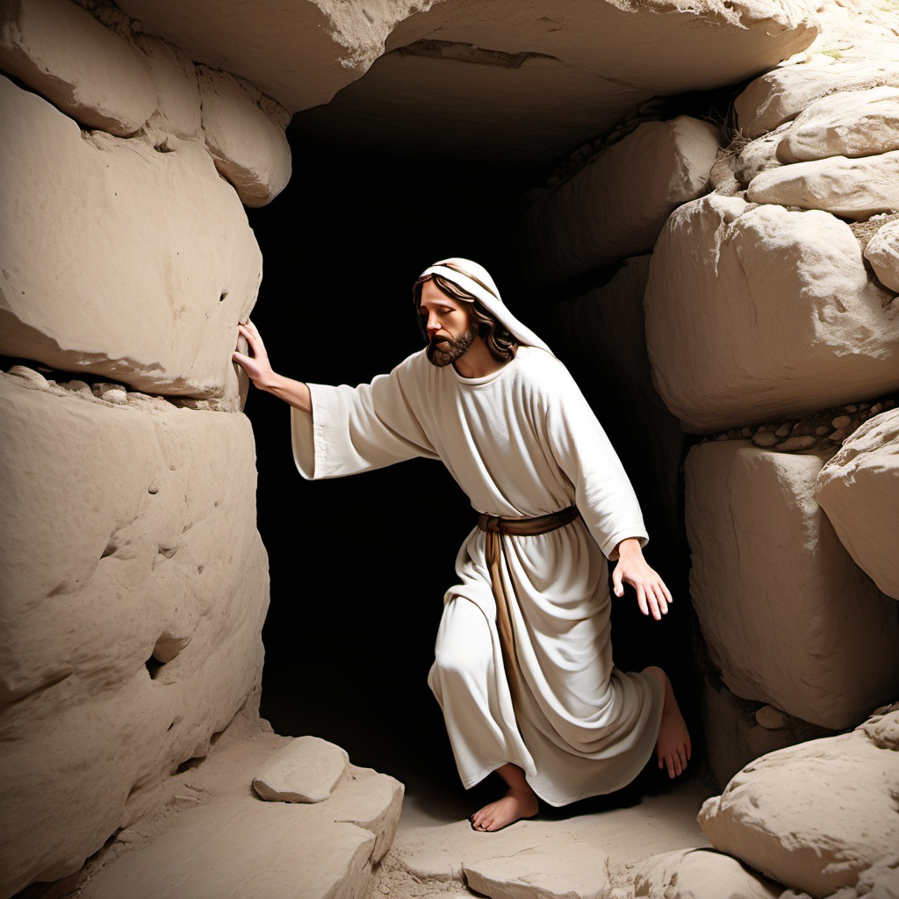
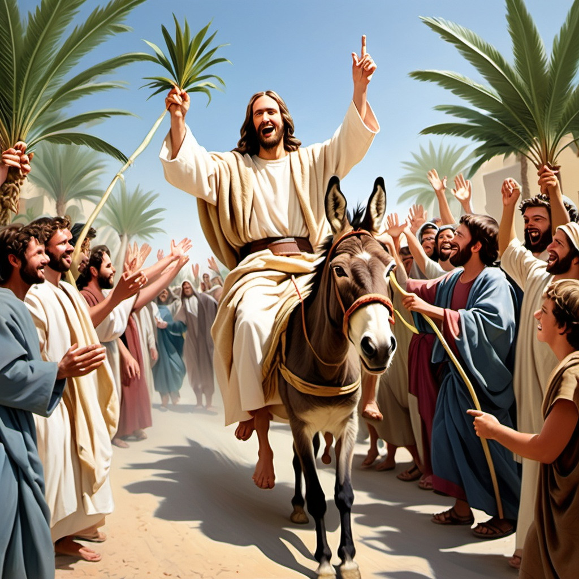
Psalms 16:10 Zechariah 9:9-10, 12:10

Slide 2
Psalms 16:10 [NIV]
You will not leave my soul in Sheol, nor will You allow Your Holy One to see corruption.

Slide 3
Zechariah 9:9-10 [NIV]
“Rejoice greatly, Daughter Zion! Shout, Daughter Jerusalem! See, your king comes to you, righteous and victorious, lowly and riding on a donkey, on a colt, the foal of a donkey. I will take away the chariots from Ephraim and the warhorses from Jerusalem, and the battle bow will be broken. He will proclaim peace to the nations. His rule will extend from sea to sea and from the River to the ends of the earth.”

Slide 4
Zechariah 12:10 [NIV]
“And I will pour on the house of David and on the inhabitants of Jerusalem the Spirit of grace and supplication; then they will look on Me whom they pierced. Yes, they will mourn for Him as one mourns for his only son, and grieve for Him as one grieves for a firstborn.”

Slide 5
The Missionaries’ Interpretation
Psalms 16:10
Jesus was resurrected.
Then [the women] went in [the tomb] and did not find the body of the Lord Jesus... Behold, two men stood by them in shining garments... They said to them, “Why do you seek the living among the dead? He is not here, but is risen!” [Luke 24:3,4b,5b-6a, NIV]
“... You will not abandon me to the realm of the dead, you will not let your holy one see decay.” [Acts 2:27, NIV]
Zechariah 9:9-10
Jesus is the King who came riding into Jerusalem on a donkey on Palm Sunday.
Then Jesus, when He had found a young donkey, sat on it; as it is written: “Fear not, daughter of Zion; behold, your King is coming, sitting on a donkey’s colt.” [John 12:14-15, NIV]
Zechariah 12:10
Jesus is the one who was pierced, while he was on the cross.
But one of the soldiers pierced His side with a spear... For these things were done that the Scripture should be fulfilled... “They shall look on Him whom they pierced.” [John 19:34a,36a,37b, NIV]

Slide 6
The Anti-Missionaries’ Interpretation
Psalms 16:10
You will not leave my soul in Sheol. Nor will You allow Your Holy One to see corruption. [Psalms 16:10, NIV]
This is a promise that God would not let King Saul kill David.
Zechariah 9:9-10
“Rejoice greatly, Daughter Zion! Shout, Daughter Jerusalem! See, your king comes to you, righteous and victorious... He will proclaim peace to the nations. His rule will extend from sea to sea and from the River to the ends of the earth.” [Zechariah 9:9a,10b, NIV]
This is a prophecy of the Messiah who will rule when he comes (only once).
Zechariah 12:10
“I will pour out upon the house of David and upon the inhabitant of Jerusalem a spirit of grace and supplications. They will look toward me because of those whom they have stabbed...” [Zechariah 12:10a, Stone Edition]
This is about a future battle in which Jewish martyrs are killed.

Slide 7
The Anti-Missionaries’ Arguments
Psalms 16 is about David, not the Messiah.
You will not leave my soul in Sheol. Nor will You allow Your Holy One to see corruption. [Psalms 16:10, NIV]
David wrote this when he was fleeing from King Saul who wanted to kill him.
This is a promise that God would not let David die.
The Psalm speaks of deliverance from death, not out of it.
There was no clear concept of resurrection when David wrote the Psalm.
Zechariah 9:9-10 cannot be about Jesus.
His rule will extend from sea to sea and from the River to the ends of the earth. [Zechariah 10:10b, NIV]
Jesus never ruled anywhere.
It’s about the true Messiah ruling the world when he comes (only once).

Slide 8
The Anti-Missionaries’ Arguments
Zechariah 12:10 is mistranslated.
... then they will look on Me whom they pierced. [NIV]
They will look toward me because of those whom they have stabbed... [Stone]
The Christian translators completely ignored the plural word, “those.”
The direct object of “stabbed” (which is the referent of “whom”) should be plural, not singular.
It refers to many people. Not just one.
They are the victims of a future, end-times battle over Jerusalem; they are Jewish martyrs.
“This mistranslation…demonstrates that the NT is fallacious” and furthermore demonstrates from the context that the NT applies it to the Roman soldiers who speared Jesus, not to Jews as the ones who did the piercing. [Rabbi Tovia Singer]

Slide 9
The Missionaries’ Rebuttal
Psalms 16 is about David, not the Messiah.
It’s a type. It has a double meaning.
It’s about God protecting David from death
AND
It’s a prophecy of Jesus’ resurrection.
There was no clear concept of resurrection when David wrote the Psalm.
Before David wrote Psalm 16: “The Lord brings death and makes alive; he brings down to the grave and raises up.” [I Samuel 2:6, NIV]
Zechariah 9:9-10 cannot be about Jesus, because he never ruled anywhere.
Jesus will rule when he comes again.

Slide 10
The Missionaries’ Rebuttal
Zechariah 12:10 is mistranslated.
What does the Talmud say?
What is the cause of the mourning... The cause is the slaying of Messiah... And they shall look upon me because they have thrust him through... [Sukkah 52a]
Original Hebrew | Google Translate | NIV | Stone
וְהִבִּיטוּ | And they looked And look | then they will look | They will look
אֵלַי | to me | on Me | toward me
אֵת | —
 |  |  | because of those
אֲשֶׁר | who which that | whom | whom
דָּקָרוּ | they stabbed | they pierced | they have stabbed

Slide 11
In Conclusion
You may decide who to believe.

