Slide 1
If your armory is on the board, you may gain three power instead of one.
If your monument is on the board, you may gain three popularity instead of one.
You may resolve this action twice. You must pay each time.
TRADE
BOLSTER
TRADE
1
2
3
You may resolve this action twice. You must pay each time.
You may resolve this action twice. You must pay each time.
If you gain two resources, you may gain two additional resources on the same territory.
BOLSTER
PRODUCE
TRADE
4
5
6
If you gain popularity, you may gain two additional popularity.
If you gain power, you may gain two additional power.
If you draw combat card(s), you may draw two additional combat cards.
TRADE
BOLSTER
BOLSTER
7
8
9
If you gain money, you may gain $2 more.
On every territory where you produce food, you may produce two additional food.
On every territory where you produce metal, you may produce two additional metal.
MOVE/GAIN
PRODUCE
PRODUCE
10
11
12
On every territory where you produce wood, you may produce two additional wood.
On every territory where you produce oil, you may produce two additional oil.
On one territory where you produce resource(s) (not workers), you may produce an additional resource of the same type.
PRODUCE
PRODUCE
PRODUCE
13
14
15
On one territory where you produce worker(s), you may produce an additional worker for the cost of one popularity.
If your mill is on the board, it produces up to three resources instead of one.
You may produce on a territory twice. This counts as two of your allotted territories.
PRODUCE
PRODUCE
PRODUCE
16
17
18
You may place resources you produce on any territories. (Lakes and the factory are territories. Home bases are not.)
If you gain resources, you may place them on any territories. (Lakes and the factory are territories. Home bases are not.)
After resolving this action, you may resolve a top-row action on a different column. Leave your action token where it is.
PRODUCE
TRADE
TRADE
19
20
21

Slide 2
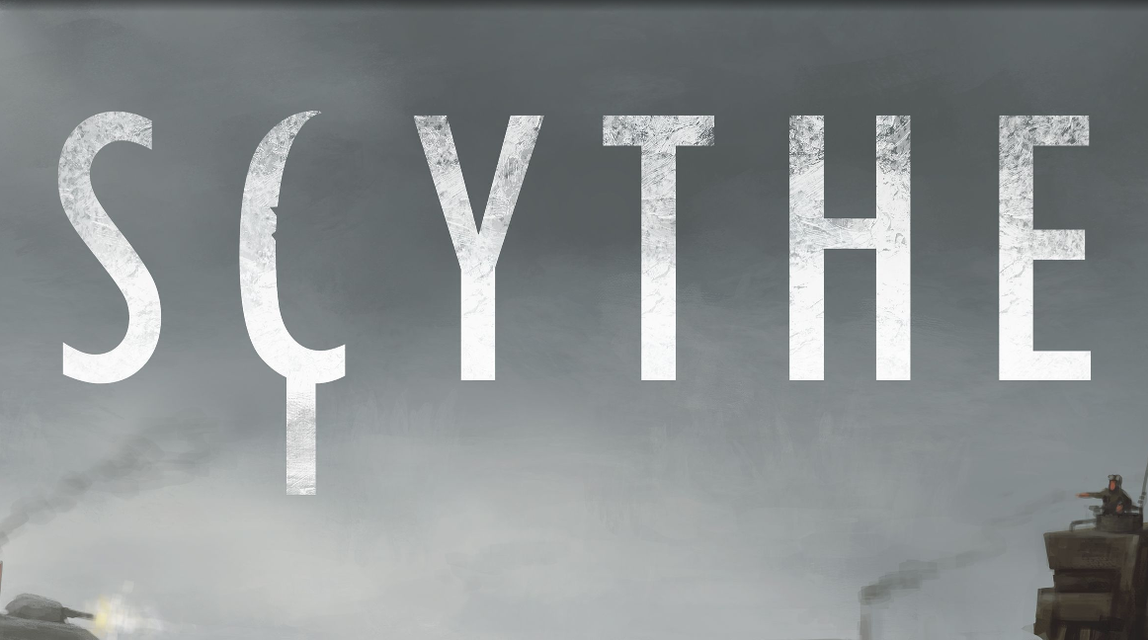
UPPER
UPPER
UPPER
UPPER
UPPER
UPPER
UPPER
UPPER
UPPER
UPPER
UPPER
UPPER
UPPER
UPPER
UPPER
UPPER
UPPER
UPPER
UPPER
UPPER
UPPER

Slide 3
After resolving this action, you may resolve a top-row action on a different column. Leave your action token where it is.
After resolving this action, you may resolve a top-row action on a different column. Leave your action token where it is.
You may gain $1 instead of paying $1.
BOLSTER
PRODUCE
TRADE
22
23
24
You may gain $1 instead of paying $1.
You do not have to pay any of the costs.
You may draw three combat cards to your hand and then discard two combat cards from your hand.
BOLSTER
PRODUCE
TRADE
25
26
27
After resolving this action, you may draw three combat cards to your hand and then discard two combat cards from your hand.
You may draw three combat cards to your hand and then discard two combat cards from your hand.
After resolving this action, you may draw two combat cards to your hand and then discard two combat cards from your hand. This happens after you get a combat card if you used power and lost the battle.
BOLSTER
PRODUCE
MOVE/GAIN
28
29
30
On your turn, after every battle, you may draw two combat cards and then discard one of them. This happens after you get a combat card if you used power and lost the battle.
On your turn, after every battle, you may keep one of the combat cards that you used.
On your turn, whenever you lose a battle, you may draw three combat cards (instead one one), even if you didn’t use any power.
MOVE/GAIN
MOVE/GAIN
MOVE/GAIN
31
32
33
Before you pay for this action, you may gain as many dollars as the tier of your popularity level, 1, 2, or 3.
Before you pay for this action, you may gain as many dollars as the tier of your popularity level, 1, 2, or 3.
Before you pay for this action, you may draw as many combat cards as the tier of your popularity level, 1, 2, or 3.
BOLSTER
TRADE
BOLSTER
34
35
36
Before you pay for this action, you may gain as many dollars as the tier of your popularity level, 1, 2, or 3.
After completing this action, you may resolve any bottom-row action. Leave your action token where it is.
After completing this action, you may resolve any bottom-row action. Leave your action token where it is.
PRODUCE
TRADE
BOLSTER
37
38
39
After completing this action, you may resolve any bottom-row action. Leave your action token where it is.
Before you pay for this action, you may pay $5 to gain 2 power.
Before you pay for this action, you may pay $5 to gain 2 power.
PRODUCE
TRADE
BOLSTER
40
41
42

Slide 4
UPPER
UPPER
UPPER
UPPER
UPPER
UPPER
UPPER
UPPER
UPPER
UPPER
UPPER
UPPER
UPPER
UPPER
UPPER
UPPER
UPPER
UPPER
UPPER
UPPER
UPPER

Slide 5
Before you pay for this action, you may pay $5 to gain 2 power.
If you move units, you may move one of those units an additional time for the cost of $1.
If you have deployed your speed mech, and you have upgraded your move action, you may move up to four units one time each.
PRODUCE
MOVE/GAIN
MOVE/GAIN
43
44
45
When you trigger an encounter, draw two cards and discard one.
When you resolve an encounter, you may pay $2 less for the middle option and/or 2 less popularity for the bottom option.
After resolving an encounter, you may pay 2 popularity to draw another encounter card and resolve it.
MOVE/GAIN
MOVE/GAIN
MOVE/GAIN
46
47
48
If you get an encounter card you don’t like, you may discard it and draw another one. You may do this up to two times.
After you resolve an encounter, you may pay 2 popularity to keep the card. Then, the next time you select this action, at the beginning of your turn, you may resolve the encounter again.
If you only move one unit, you may gain 2 power before moving.
MOVE/GAIN
MOVE/GAIN
MOVE/GAIN
49
50
51
At the end of every battle, if you spent any power, you may get one back.
You may increase your power by one before each battle on a territory next to a lake.
You may increase your power by one before each battle on a territory next to a tunnel (not a mine).
MOVE/GAIN
MOVE/GAIN
MOVE/GAIN
52
53
54
Before each battle, you may decrease your popularity by 1 or 2 to gain the same amount of power.
At the beginning of your turn, you may increase your power by one.
When you attack, you may use one additional combat card with a value of 2.
MOVE/GAIN
MOVE/GAIN
MOVE/GAIN
55
56
57
In every battle where you would normally be able to use only one combat card, you may use two.
You may pass on this action, and then on the following turn, resolve this action twice.
If you are entitled to a factory card, before choosing one, draw two additional factory cards. After choosing which card you want to keep, discard any two of the remaining cards.
MOVE/GAIN
MOVE/GAIN
MOVE/GAIN
58
59
60
Instead of resolving this action, you may place your speed mech on the board for the cost of 2 metal.
Before you resolve this action, you may change one of your mech powers by moving a mech that hasn’t been deployed to an uncovered mech’s space.
Your character may carry workers and mechs, and your mechs may carry mechs and your character.
MOVE/GAIN
MOVE/GAIN
MOVE/GAIN
61
62
63

Slide 6
UPPER
UPPER
UPPER
UPPER
UPPER
UPPER
UPPER
UPPER
UPPER
UPPER
UPPER
UPPER
UPPER
UPPER
UPPER
UPPER
UPPER
UPPER
UPPER
UPPER
UPPER

Slide 7
Your mechs have the same powers as your character.
If you move and do not attack anyone, you may set your power to 7.
You do not lose popularity for forcing opponents’ worker(s) to retreat, even if you don’t have a battle on their territory.
MOVE/GAIN
MOVE/GAIN
MOVE/GAIN
64
65
66
One of your units may cross one lake that has no opponents’ units on it. It may not stop on the lake.
After you deploy your riverwalk mech, you may cross rivers to any type of territory that is not a lake.
On each turn, one teleportation move (such as a move through a tunnel) doesn't count as one of your moves.
MOVE/GAIN
MOVE/GAIN
MOVE/GAIN
67
68
69
On one move, you may pass through one territory that has an opponent’s units without stopping.
For you, the 3 on the combat dial is an 8.
At the end of this action, if the factory is empty, place a star on it. If your character is there at the end of any turn, place that star on the Triumph Track as a combat star.
MOVE/GAIN
MOVE/GAIN
MOVE/GAIN
70
71
72
You may take $2 more.
You may take $2 more.
You may take $2 more.
UPGRADE
DEPLOY
BUILD
73
74
75
You may take $2 more.
You may draw three combat cards to your hand and then discard two combat cards from your hand.
You may draw three combat cards to your hand and then discard two combat cards from your hand.
ENLIST
UPGRADE
DEPLOY
76
77
78
You may draw three combat cards to your hand and then discard two combat cards from your hand.
At the end of your turn, you may draw three combat cards to your hand and then discard two combat cards from your hand.
At the end of your turn, you may pay power and popularity to gain the same amount of money, up to $4.
BUILD
ENLIST
UPGRADE
79
80
81
At the end of your turn, you may pay power and popularity to gain the same amount of money, up to $4.
At the end of your turn, you may pay power and popularity to gain the same amount of money, up to $4.
At the end of your turn, you may trade up to 5 popularity for the same amount of power or vice versa.
BUILD
ENLIST
UPGRADE
82
83
84

Slide 8
UPPER
UPPER
UPPER
UPPER
UPPER
UPPER
UPPER
UPPER
UPPER
LOWER
LOWER
LOWER
LOWER
LOWER
LOWER
LOWER
LOWER
LOWER
LOWER
LOWER
LOWER

Slide 9
At the end of your turn, you may trade up to 5 popularity for the same amount of power or vice versa.
At the end of your turn, you may trade up to 5 popularity for the same amount of power or vice versa.
At the end of your turn, you may trade $5 for 2 power or vice versa.
DEPLOY
BUILD
UPGRADE
85
86
87
At the end of your turn, you may trade $5 for 2 power or vice versa.
At the end of your turn, you may trade $5 for 2 power or vice versa.
At the end of your turn, you may trade $5 for 2 popularity or vice versa.
DEPLOY
ENLIST
DEPLOY
88
89
90
At the end of your turn, you may trade $5 for 2 popularity or vice versa.
At the end of your turn, you may trade $5 for 2 popularity or vice versa.
You may discard one combat card to gain as many dollars as the value of the card.
BUILD
ENLIST
UPGRADE
91
92
93
You may discard one combat card to gain as many dollars as the value of the card.
You may discard one combat card to gain as many dollars as the value of the card.
At the end of your turn, you may discard one combat card to gain as many dollars as the value of the card.
DEPLOY
BUILD
ENLIST
94
95
96
You may reduce the cost by one oil.
You may reduce the cost by one metal.
You may reduce the cost by one wood.
UPGRADE
DEPLOY
BUILD
97
98
99
You may reduce the cost by one food.
You may draw one combat card.
ENLIST
You may gain one power.
UPGRADE
DEPLOY
100
101
102
BUILD
ENLIST
If you have enlisted this action’s recruit, you may gain 3 power instead of 1.
You may gain one popularity.
You may gain one popularity.
UPGRADE
103
104
105

Slide 10
LOWER
LOWER
LOWER
LOWER
LOWER
LOWER
LOWER
LOWER
LOWER
LOWER
LOWER
LOWER
LOWER
LOWER
LOWER
LOWER
LOWER
LOWER
LOWER
LOWER
LOWER

Slide 11
If you have enlisted this action’s recruit, you may gain $3 instead of $1.
If you have enlisted this action’s recruit, you may gain 3 popularity instead of 1.
If you have enlisted this action’s recruit, you may draw 3 combat cards instead of 1.
DEPLOY
BUILD
ENLIST
106
107
108
Before or after doing the upgrade action, you may move one of your cubes to an empty space on the same row.
You may place your new mech on a territory adjacent to any of your units that is not occupied by any opponent’s units.
You may place your new structure on a territory adjacent to any of your units that is not occupied by any opponent’s units.
UPGRADE
DEPLOY
BUILD
109
110
111
After moving your recruit, you may take the one-time bonus twice.
You may build on a territory that already has a structure. A territory with more than one player’s structures is not controlled unless there are units there.
At the end of your turn, if you have no combat cards, you may draw four and discard three of them.
ENLIST
BUILD
DEPLOY
112
113
114
Instead of paying for an upgrade, you may gain 2 oil. If you do, you may not upgrade.
Instead of paying for the deployment, you may gain 2 metal. If you do, you may not deploy a mech.
Instead of paying for the build, you may gain 2 wood. If you do, you may not build a structure.
UPGRADE
DEPLOY
BUILD
115
116
117
Instead of paying for the enlistment, you may gain 2 food. If you do, you may not enlist a recruit.
After you get an upgrade, you may pay 4 oil to get another upgrade. You may not repeat any of the other bonuses.
After you deploy a mech, you may pay 4 metal to deploy another mech. You may not repeat any of the other bonuses.
ENLIST
UPGRADE
DEPLOY
118
119
120
After you build a structure, you may pay 4 wood to build another structure. You may not repeat any of the other bonuses.
After you enlist a recruit, you may pay 4 food to enlist another recruit. You may not repeat any of the other bonuses.
FACTORY
MOVE
BUILD
ENLIST
If you have deployed your speed mech, you may move one unit up to four times.
121
122
123

Slide 12
LOWER
LOWER
LOWER
LOWER
LOWER
LOWER
LOWER
LOWER
LOWER
LOWER
LOWER
LOWER
LOWER
LOWER
LOWER
LOWER
LOWER
LOWER

